Slide 1

CUSTOMER VALUE ANALYSIS REGRESSION PROCESS
By
Kaushik Chandra Nagarajan

Slide 2
Introduction
Auto Insurance Data gives insights about the customer lifetime value.
CLV is the total revenue the client will derive from their entire relationship with a customer based on it we predict and draw some business recommendation

Slide 3
Dataset Description
This dataset consists of attributes such as customer lifetime value, state, gender, policy type, vehicle type, vehicle size etc…..
This dataset consists of 9134 rows and 24 columns.

Slide 4
Objectives
Analyze data for the given auto insurance company
1
Help the company to optimize business and maximize profit
2
Depict trends which will help in improving business of the company
3

Slide 5

Significant Variables
Customer Lifetime Value
Monthly Premium Auto
Total Claim Amount
Coverage
Education
Employment Status
Marital Status
Type of Open Complaints
Type of Policies
Renew Offer Type
Vehicle Class

Slide 6

Insignificant Variables
Customer
Gender
Response
Location Code
Policy
Policy Type
Sales Channel

Slide 7
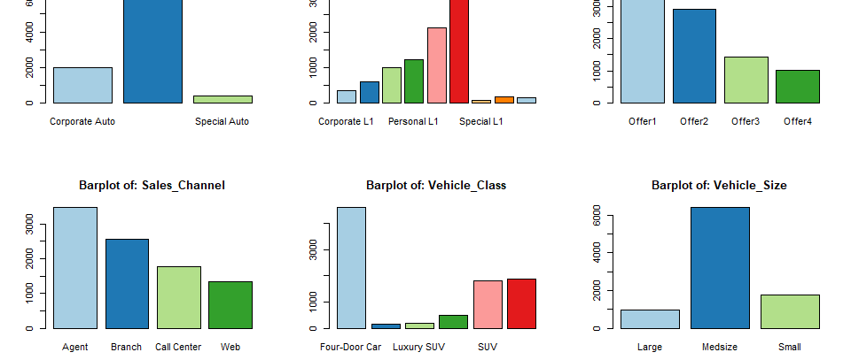
Bar-Plots

Slide 8
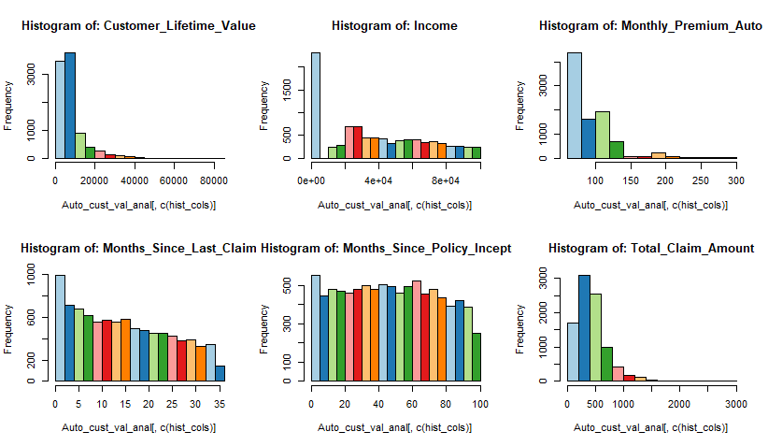
Histograms

Slide 9
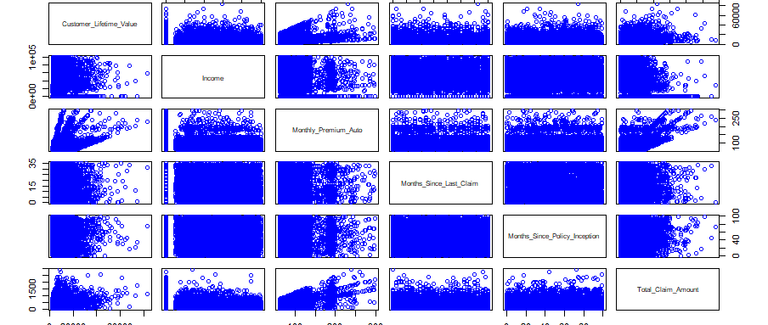
Scatter Plots

Slide 10
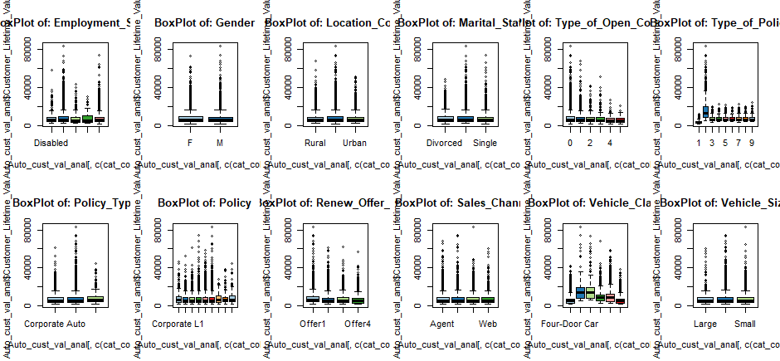
Boxplots

Slide 11
Tests for the Model
Multiple R squared and adjusted R squared
Multiple R-squared= 0.639, Adjusted R- squared =0.6382
If multiple R-squared is more than adjusted R-squared, it indicates that the ,model is having a good fit.
Tests for serial correlation
Autocorrelation occurs when the residuals are not independent from each other
Null Hypothesis HO: No autocorrelation
p- value > 0.05 means HO is accepted
p-value = 0.854 Null Hypothesis is accepted

Slide 12
Tests for the Model
Tests for Normality
Null hypothesis
HO: Errors are normally distributed
p-value < 0.00000000000000022
Null hypothesis is rejected
Tests for homoskedasticity
Null hypothesis
HO: there exists homoskedasticity , error variances are equal
P-value < 0.00000000000000022
Null hypothesis is rejected

Slide 13

Mean and Median Accuracies
Linear Regression
Mean Accuracy of Linear Regression Model is: 76.125
Median Accuracy of Linear Regression Model is: 83.890
Decision Tree
Mean Accuracy of Decision Tree is: 14
Median Accuracy of Decision Tree is: 94.645

Slide 14
Business Recommendations
Offer good customer service
Provide Value-Packed Content That Keeps Customers Engaged
Listen to Your Customers
Detect Common Pain Points & Provide Solutions
Offer Your Clients a Personalized Experience
Use Customer Success Software
Improve the Onboarding Process

Slide 15


THANK YOU

